Slide 1
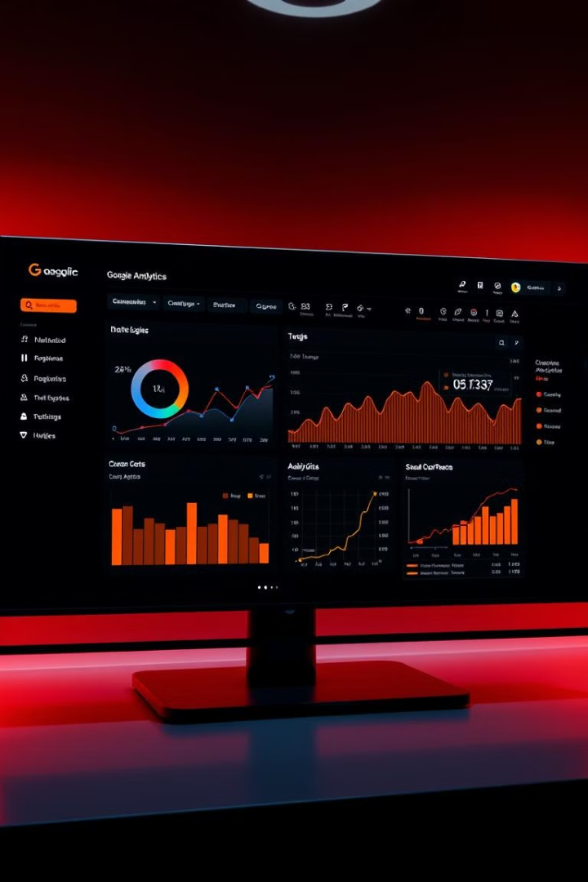
Customer Behavior Prediction with Google Analytics

Slide 2

TEAM MEMBERS
2210030235- S. Sai Kiran
2210030232- A. Harsha
2210030063- Y. V. Sai Kiran
2210030212- B. Praveen

Slide 3
Unleashing the Power of Google Analytics
Google Analytics is a powerful tool that provides insights into customer behavior.
It collects vast amounts of data, offering a comprehensive view of customer journeys.

Slide 4
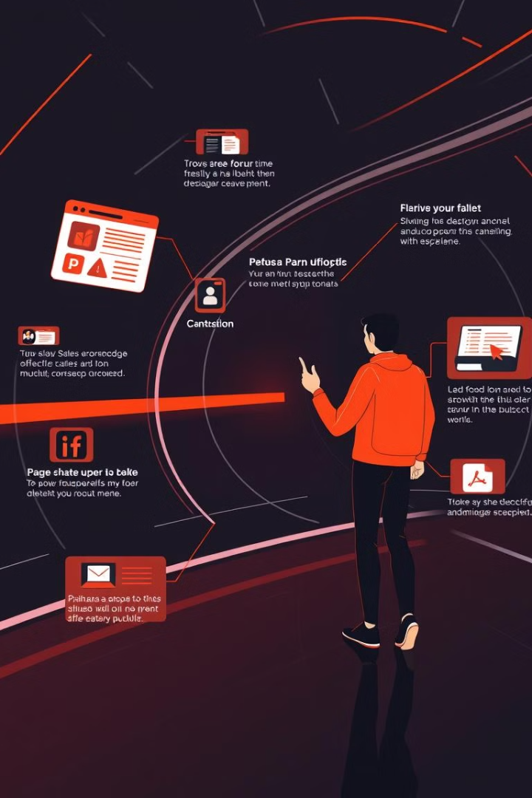
Primary Goals: Understanding and Optimizing
1
Understand Customer Journeys
Gain deep insights into how customers interact with your website or app.
2
Optimize Marketing Strategies
Improve campaign effectiveness by predicting customer responses and preferences.

Slide 5
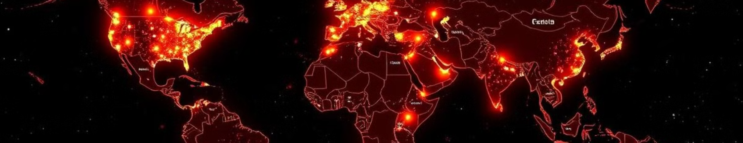
Identifying Growth Opportunities
Product Development
Marketing Campaigns
Website Optimization
Identify areas where customer demand is increasing.
Target specific customer segments based on their behavior.
Improve user experience by identifying areas for improvement.

Slide 6
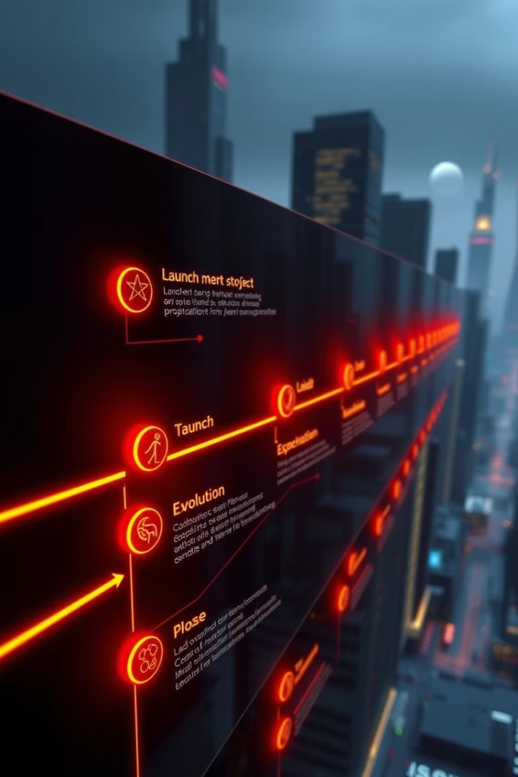
Project Timeline and Milestones
1
Data Collection and Preparation
2
Model Development and Training
3
Model Validation and Testing
4
Implementation and Deployment

Slide 7
Data Collection and Analysis
Collect relevant data from Google Analytics.
Clean and prepare the data for analysis.
Identify key features that influence customer behavior.

Slide 8

Predictive Modeling
Select a suitable model
Choose a model that aligns with the project goals.
Train the model
Feed the model with data to learn patterns.
Evaluate the model's performance
Test the model's accuracy and reliability.

Slide 9
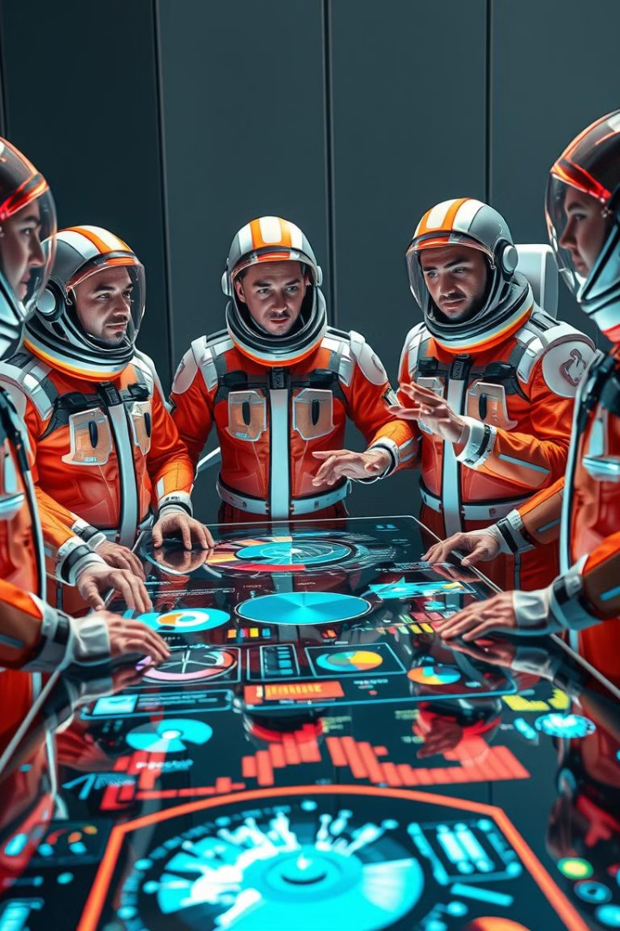



Turning Insights into Action
Targeted Marketing
Website Optimization
Product Development
Reach the right customers with personalized messages.
Improve user experience and engagement.
Create products that meet customer needs.

Slide 10



Summary and Key Takeaways
Predictive Analytics
1
Leverage Google Analytics data for powerful predictions.
Data-Driven Decisions
2
Make informed decisions based on customer insights.
Growth and Optimization
3
Drive business growth and optimize customer experience.

